Slide 1
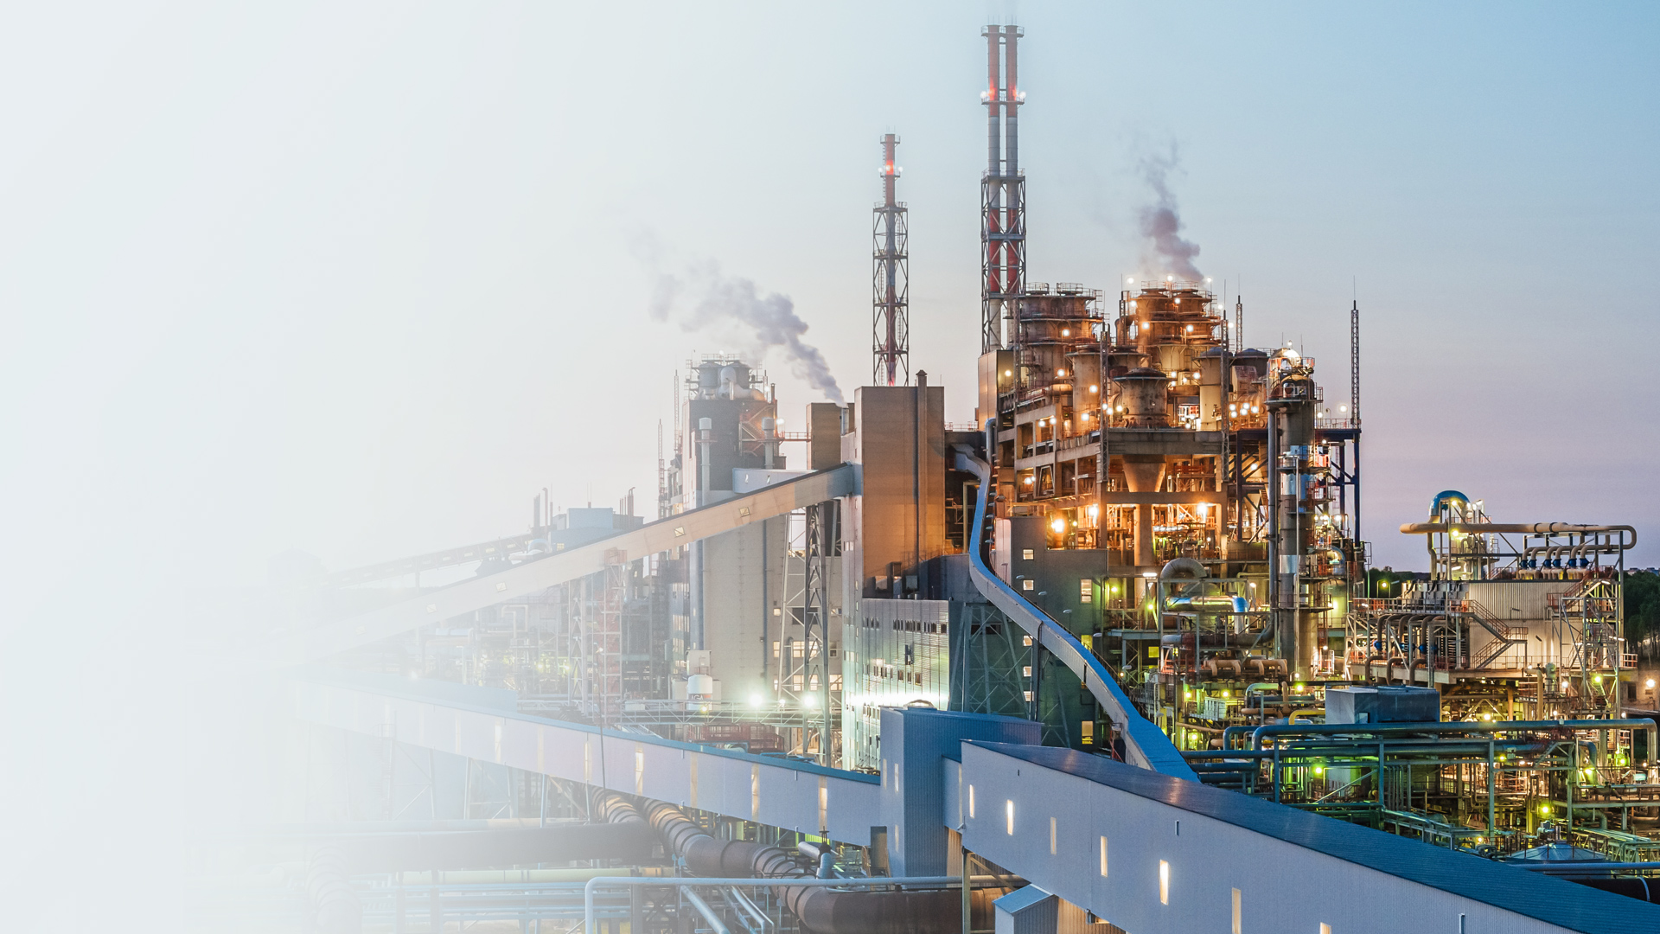
Estonian Shale Oil Markets
Rustin Edwards
Fuel Oil products Sales Lead
VKG Gmbh
19.10.2026

Slide 2
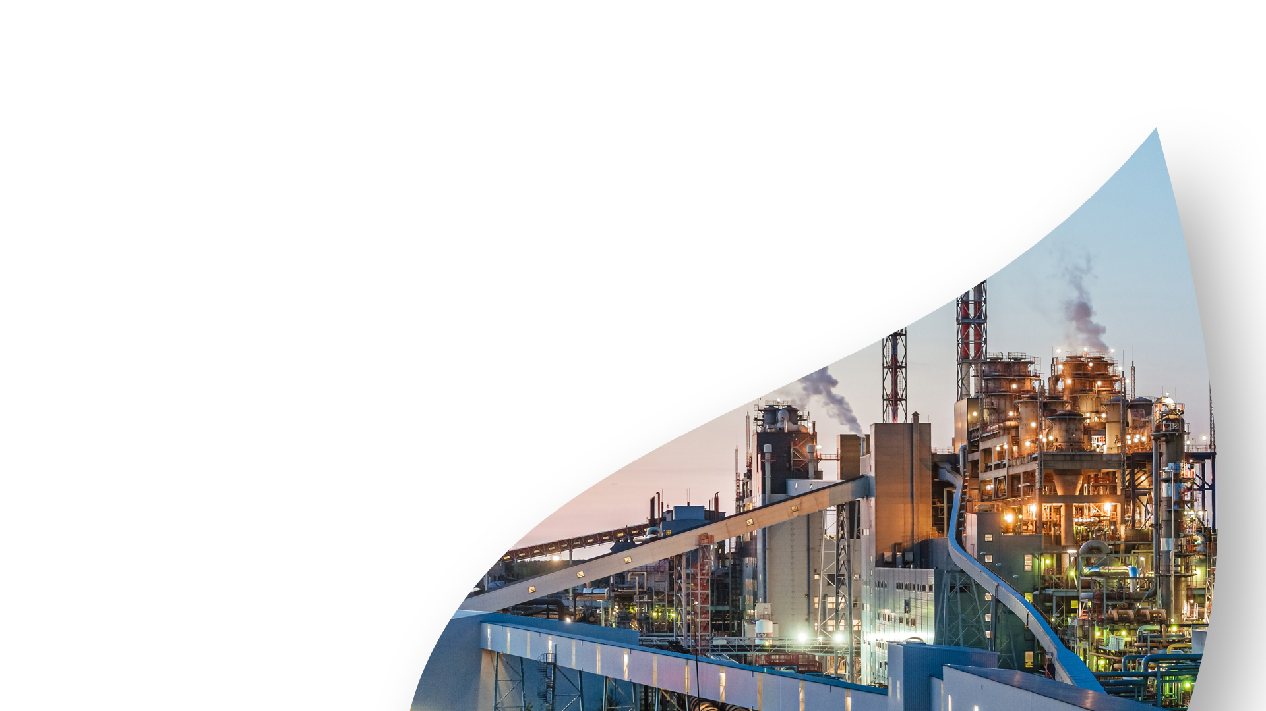
Locally Produced…
..Globally Influenced.
Presentation to ESTIS
19 October 2026

Slide 3

Introduction
Over 25 years in the petroleum industry
Worked in all sections of the oil supply chain
Trading Oil for over 16 years
  Bunker Fuel Blending
  Refinery Feedstock supply and trading
  Derivative Markets
  Gasoline Markets
Recently worked for one of the largest publicly traded oil transportation companies, EURONAV.
  Suezmax and VLCC vessels
  130 to 270 KT in volume.

Slide 4
Question 1: How large is the Global Oil Market?
Yes…..this is a test!
A) Approx 95 Million Barrel Per day
B) Approx 102 Million Barrels per day
C) Approx 110 Million barrels per day
D) Approx 83 Million barrels per day

Slide 5
Answer:
The current world oil demand is approximately 102.2 Million BOE per day…
BOE – Barrel of Oil Equivalent
  Crude Oil
  Condensate
  Natural Gas Liquids
In 2023 only 83.6 Million barrels per day of Crude Oil was run in refineries.
  Balance was into other production facilities such as petrochemical feeds

Slide 6
Locally Produced…Globally Influenced.
Estonian shale oil is part of a global petroleum market.
Estonia exports 98% of the oil produced from Shale
We feel the impact of global markets in…
  The Price we get..
  The Demand we get..
Estonian shale ends up in markets across the globe..

Slide 7
Part of a greater supply chain
Estonia produces 3 main grades of petroleum for export:
  Shale Gasoline
  Residual Fuel Oil D-2 grade
  Phenols
All are purchased from producers and blended into the global supply chains for
  Gasoline or Naphtha
  Bunker and Utility Fuels
  Tire and synthetic rubber manufacturing

Slide 8
Question 2: How much of shale gasoline is consumed in the EU per year?
A) 100%
B) 25%
C) 0%
D) 65%

Slide 9
Answer:
None of the Estonian shale gasoline is consumed in the EU
Blended into larger parcels that are exported out of the EU..
  Or exported to blend hubs and then moved out of the EU.
Used as a feedstock into refinery upgrading capacity.
WHY?
EU Fuel Regulations on sulfur content as well as other quality standpoints that would make blending shale gasoline into retail EU Gasoline impossible to meet.

Slide 10
Where does the shale gasoline blends go?
A) Caribbean
B) Africa
C) Pakistan
D) Brazil

Slide 11
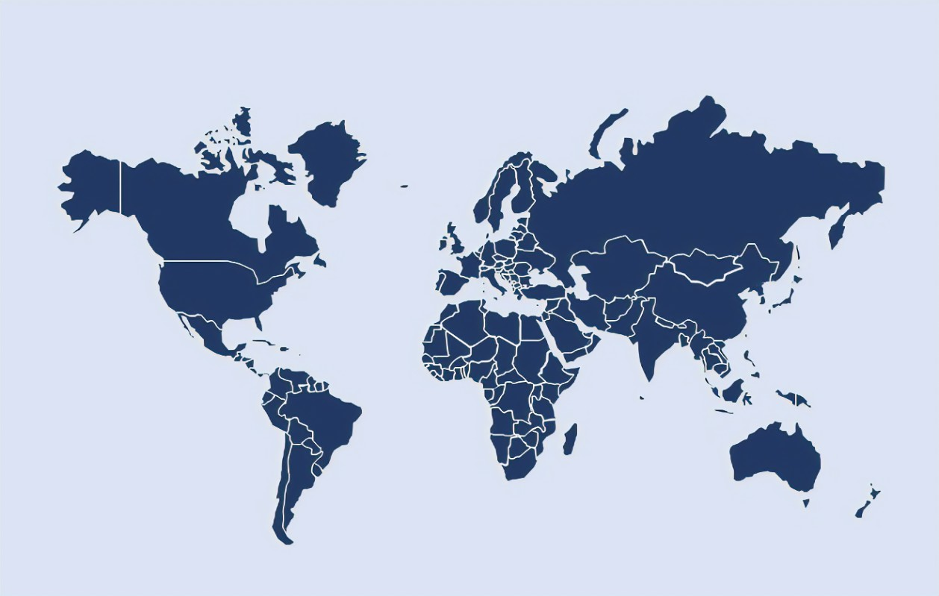

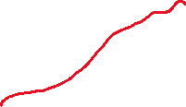




Answer

Slide 12
Challenges Facing Gasoline Markets
As with any voyage forward, there is the chance of headwinds…
Fuel oil standards are becoming more stringent globally
  Reduce impurities
  Tighter sulfur
New refinery capacity coming on line that will disrupt the Atlantic basin flows and challenge blending economics

Slide 13
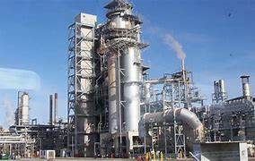
Challenges Ahead– New Refining
African Refineries
  Dangote - Nigeria
  Suento - Ghana
  Port Harcourt - Nigeria
  Has Made West Africa a net exporter of product
Dos Bocas Mexico
  Will reduce imports from USA

Slide 14
Gasoline demand destruction is happening
EV and Hybrid car sales are eclipsing ICE sales in major markets
  China
  Europe
  USA
Impact of alternative energy vehicles has contributed to approximately 2 million barrels a day of retail fuel demand destruction
  Once investment in EV has been made, consumers do not switch back.
The current high retail gasoline price environment is shifting consumer sentiment on EV vs. ICE engines.
  As of August 2026 EV and Hybrid cars amounted to 58.3% of new car registrations

Slide 15
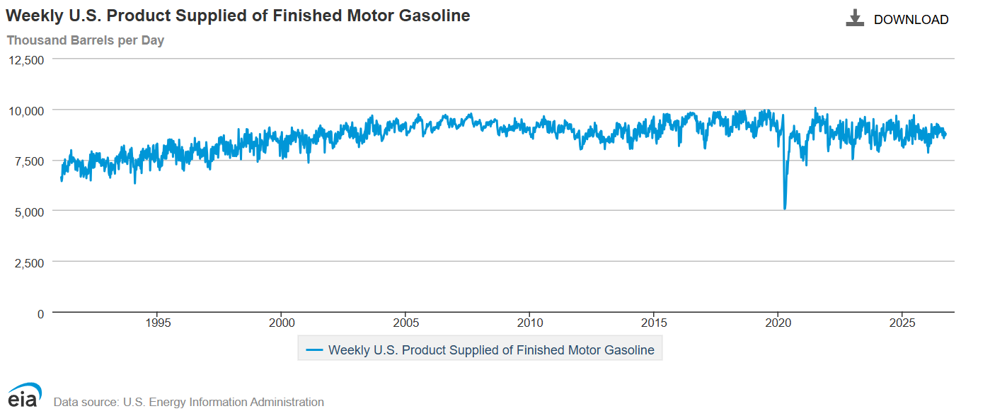
Peak Gasoline Demand in USA?
US gasoline demand has already peaked according to the EIA
  And has started to decline…
  China petroleum demand is estimate to peak by 2027 with gasoline peaking this year…

Slide 16
Where does our Residual Fuel go?
A) Exported to Singapore
B) Exported to Rotterdam
C) Exported to USA
D) Exported to Brazil

Slide 17


Answer

Slide 18
Residual Fuel Oil Market
80% of Estonian shale is exported directly to Asia
  Singapore and Malaysia bunker hub
10% is shipped into ARA….
  Where it is blended and shipped to Singapore as well
10% disbursed to other European markets for bunker and utility consumption.

Slide 19
Bunker Markets and Shale
Global bunker fuel consumption is 220 Million Metric Tons annually
HSFO (Max 3.5% Sulfur) makes up over 1/3rd of the global bunker demand
VLSFO (Max 0.5% Sulfur) makes up the balance and is widely available in the world today.
Estonian Shale oil is a global blend component for VLSFO…
Sulfur is below 0.7% typically.
Estonian Shale makes up a little less than 1% of the global bunker market, but it is a sought-after component for blending
Quality Wise:
Low sulfur, High Density material needed in today's bunker fuel market, and beyond.

Slide 20
Challenges Ahead for Fuel Oil
As with gasoline, there are some challenges for residual fuel
Changes in global bunker demand for residual fuel
  Mediterranean SECA zone came into effect on May 1, 2025
    Reduces sulfur emissions from 0.5% to 0.1% for vessels in the Mediterranian
  GIUK ECA zone to come into effect in 2028
    Further in crease in marine distillate demand and reduction in Marine Fuel Bunker demand
  Alternative fuels for ships
    Biofuel Blends
    Methanol
    Ammonia

Slide 21
Estonian Shale Staying Power
Refinery rationalization in Europe
  Has resulted in some refinery shut downs prior to the Middle East war.
  Lower demand for product
    Both inside EU and exports
Would mean less fuel oil produced in Northern Europe
Would help maintain Estonian Shale as a marine fuel blend component.

Slide 22
Regulatory Risk is largest risk
IMO Net Zero Framework
  Global Carbon Tax on emissions
  Has yet to pass within the IMO
Fuel EU regulations
  Tightening down on emissions from vessels
    Produces a cost to shippers for burning petroleum based fuels
EU Emissions regulations

Slide 23
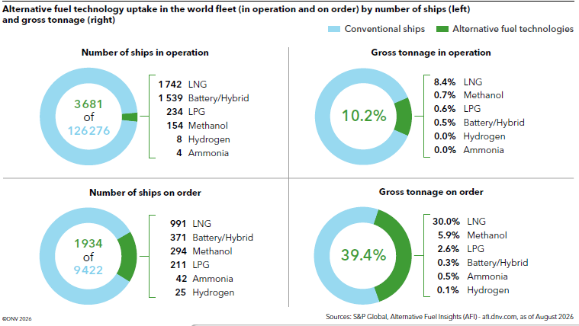
Shipping Demand for Fuel oil
We are in an energy transition not a cancelation….
90.8% of the global fleet tonnage in operation currently relies on conventional fuels (HSFO/VLSFO/Gasoil) for energy.
8.4% of the fleet relies on LNG as the main source of energy.
30% of the new order book is LNG powered.
5.9% is Methanol.
Vessel orders require 4 to 5 years from order to completion….Meaning that maritime is behind the curve in vessel replacement.

Slide 24
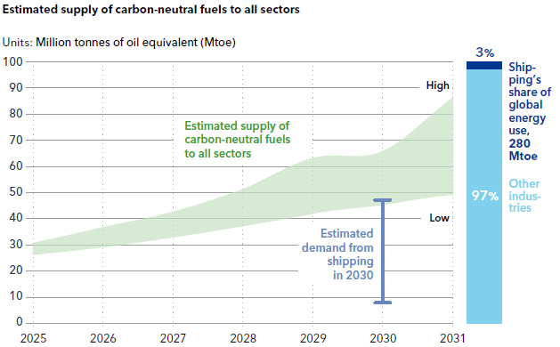
Supply Chain on Green Fuels
Investment in the green supply chain is lacking, resulting in limited uptake on green investment in shipping.
Green transition in infrastructure alone roughly 2 Trillion USD up to 10 Trillion USD globally.
Competition for Green fuels will be Great with methanol and ammonia having a well-established global market which will need to decarbonize along with maritime.
Certification and Compliance of green fuels will be essential for a successful transition.
Chart provided from DNV Maritime Forecast to 2050

Slide 25
….Further impacts on Marine Demand.
In order to meet the goals of the IMO a combination of things must take place:
More efficient vessel operations – Ongoing and impacting operations today!
Engineered solutions
  From Coatings to on board emissions abatement – ongoing and impacting operations today…
Machinery upgrades – Ongoing and impacting operations today
Alternative fuels – in development….
The factors of development in the alternative fuels market will keep petroleum as part of the overall fuel mix into 2040 and beyond…
….Petroleum based fuels, such as Estonian Shale, will be used during the transition up to 2050 and potentially beyond.

Slide 26
Forecast for 2027 oil markets
Where are markets going for 2027? What will the price of Oil?
Depending on your point of view and expectations of supply and demand.
Current market has been dictated primarily by Geopolitical risk providing support with little impact from macro economic factors.
Could change in a high interest rate environment.

Slide 27
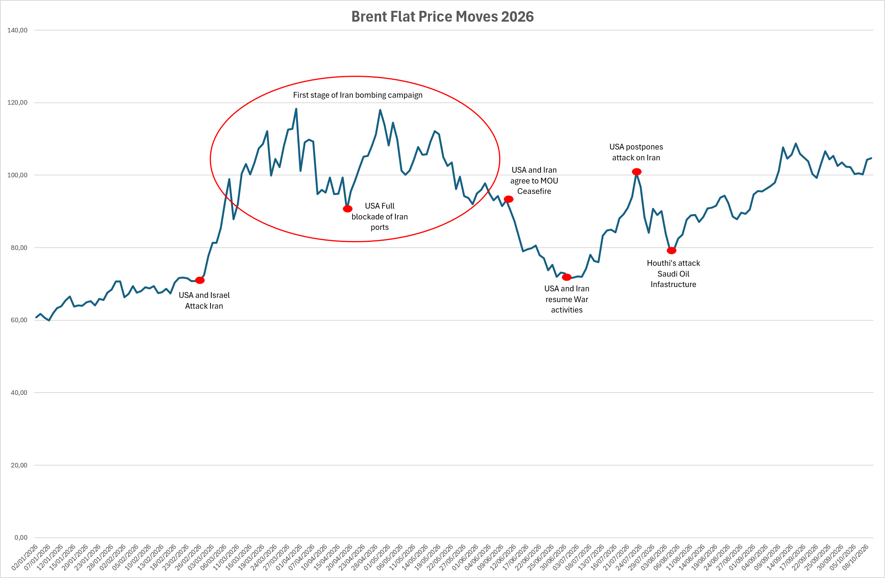
Notable events impacting Brent Flat Price 2026 YTD

Slide 28
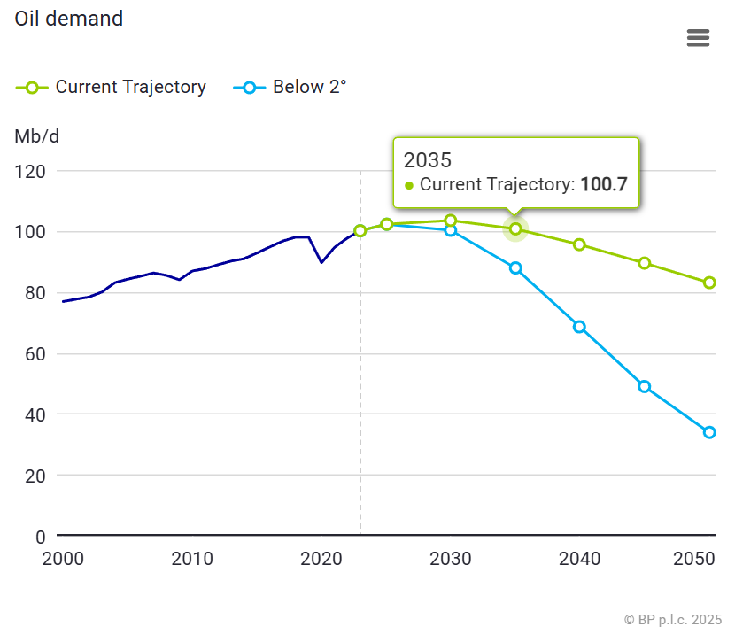
Crude oil Supply and Demand
BP in their annual oil report is calling for peak oil demand to hit in 2030.
Peak demand is attributed too:
Efficiency gains on ICE and Jet Turbines
Adoption of alternative energy sources within power grids
EV adoption for transportation and logistics
Uptake of alternative fuel sources
  Nat Gas/LNG
  Methanol
  Biofuel
Similar conclusions from other oil majors..

Slide 29
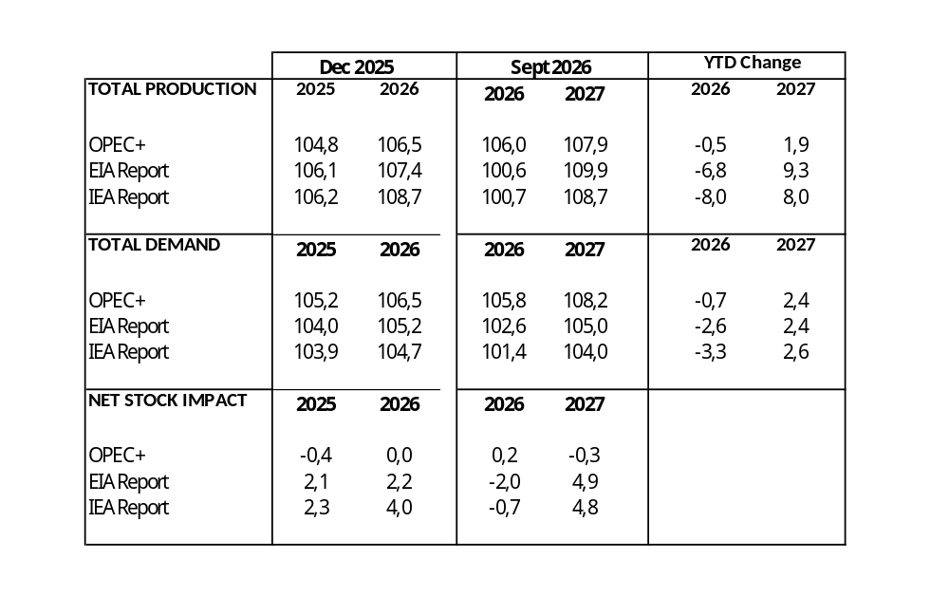
Crude Oil Supply and Demand
Government reporting shows that demand remains to outpace supply in 2026.
  Average is about 1.6 MBPD
  China import cuts the main driver to lower demand
Analyst show that in 2027, market could shift to over supply situation
  New production coming on line from Latin America and return of Middle East production
  Demand returns to 2025 levels
  Demans is lower as alternative energy consumption grows
Freight markets will play into the overall profile going into 2027

Slide 30
Forecast for 2027 oil markets
So what does that mean for prices going forward?
Range bound trade with a potential for higher prices..
Cannot discount a price crash due to the power of the tweet….

Slide 31
Questions?

